Slide 1

Session 01
Build Application Using C#

Slide 2
Objectives
Define and describe the .NET Framework
Explain the C# language features
Define and describe the Visual Studio 2012 environment
Explain the elements of Microsoft Visual Studio 2012 IDE

Slide 3
Introduction to .NET Framework
The .NET Framework is an infrastructure that is used to:
Build, deploy, and run different types of applications and services using .NET technologies.
Minimize software development, deployment, and versioning conflicts.
Is a programming platform that is used for developing Windows, Web-based, and mobile software.
Has a number of pre-coded solutions that manage the execution of programs written specifically for the framework.
Is based on two basic technologies for communication of data:
eXtensible Markup Language (XML)
The suite of Internet protocols

Slide 4
Evolution of The .NET Framework 1-2
Microsoft has released different versions of the .NET Framework to include additional capabilities and functionalities with every newer version.
Following are the versions of the .NET Framework:
.NET Framework 1.0
.NET Framework 1.1
.NET Framework 2.0
.NET Framework 3.0
.NET Framework 3.5
.NET Framework 4.0
.NET Framework 4.5

Slide 5
Evolution of The .NET Framework 2-2
The following table shows various versions of.NET Framework and Visual Studio:
Year | .NET Framework | Distributed with OS | IDE Name
2002 | 1.0 |  | Visual Studio .NET (2002 )
2003 | 1.1 | Windows Server 2003 | Visual Studio .NET 2003
2005 | 2.0 |  | Visual Studio 2005
2006 | 3.0 | Windows Vista, Windows Server 2008 | Visual Studio 2005 with .NET Framework 3.0 support
2007 | 3.5 | Windows 7, Windows Server 2008 R2 | Visual Studio 2008
2010 | 4 |  | Visual Studio 2010
2012 | 4.5 | Windows 8, Windows Server 2012 | Visual Studio 2012

Slide 6
.NET Framework Components
The two core components of the .NET Framework integral to any application or service development are:
Common Language Runtime (CLR)
Is a backbone of .NET Framework
Performs various functions such as:
Memory management
Code execution
Error handling
Code safety verification
Garbage collection
.NET Framework Class Library (FCL)
Is a comprehensive object-oriented collection of reusable types.
Is used to develop applications ranging from traditional command-line to Graphical User Interface (GUI) applications that can be used on the Web.

Slide 7
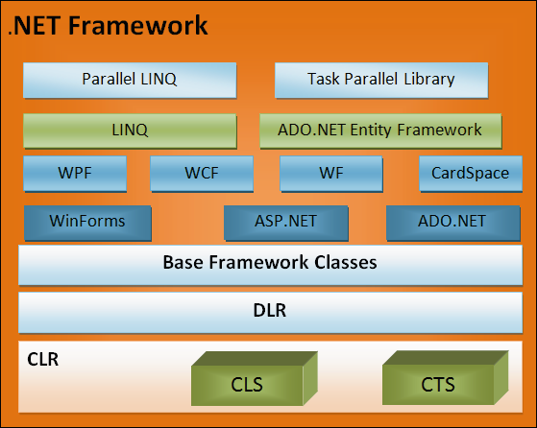
Other Components of .NET Framework 1-4
Following are some other important components:
Common Language Specification (CLS)
Common Type System (CTS)
Base Framework Classes
ASP.NET
ADO.NET
WPF
WCF
LINQ
ADO.NET Entity Framework
Parallel LINQ
Task Parallel Library

Slide 8
Other Components of .NET Framework 2-4
Common Language Specification (CLS):
Is a set of rules that any .NET language should follow to create applications that are interoperable with other languages.
Common Type System (CTS):
Describes how data types are declared, used, and managed in the runtime and facilitates the use of types across various languages.
Base Framework Classes:
These classes provide basic functionality such as input/output, string manipulation, security management, network communication, and so on.
ADO.NET:
Provides classes to interact with databases.

Slide 9
Other Components of .NET Framework 3-4
ASP.NET:
Provides a set of classes to build Web applications. ASP.NET Web applications can be built using Web Forms, which is a set of classes to design forms for the Web pages similar to the HTML.
Supports Web services that can be accessed using a standard set of protocols.
WPF:
Is a UI framework based on XML and vector graphics.
Uses 3D computer graphics hardware and Direct3D technologies to create desktop applications with rich UI on the Windows platform.
WCF:
Is a service-oriented messaging framework.
Allows creating service endpoints and allows programs to asynchronously send and receive data from the service endpoint.

Slide 10
Other Components of .NET Framework 4-4
LINQ:
Is a component that provides data querying capabilities to a .NET application.
ADO.NET Entity Framework:
Is a set of technologies built upon ADO.NET that enables creating data-centric applications in object-oriented manner.
Parallel LINQ:
Is a set of classes to support parallel programming using LINQ.
Task Parallel Library:
Is a library that simplifies parallel and concurrent programming in a .NET application.

Slide 11
Common Intermediate Language (CIL) 1-2
Every .NET programming language generally has a compiler and a runtime environment of its own.
The compiler converts the source code into executable code that can be run by the users.
One of the primary goals of .NET Framework is to combine the runtime environments so that the developers can work with a single set of runtime services.
When the code written in a .NET compatible language such as C# or VB is compiled, the output code is in the form of MSIL code.
MSIL is composed of a specific set of instructions that indicate how the code should be executed.
MSIL is now called as Common Intermediate Language (CIL).

Slide 12
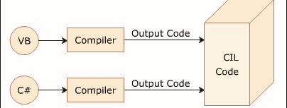
Common Intermediate Language (CIL) 2-2
The following figure depicts the concept of CIL:

Slide 13
Common Language Runtime (CLR) 1-3
The CLR:
Is the foundation of the .NET Framework.
Acts as an execution engine for the .NET Framework.
Manages the execution of programs and provides a suitable environment for programs to run.
Provides a multi-language execution environment.
The runtime manages code at execution time and performs operations such as:
Memory management
Thread management
Remoting
The .NET Framework supports a number of development tools and language compilers in its Software Development Kit (SDK).

Slide 14
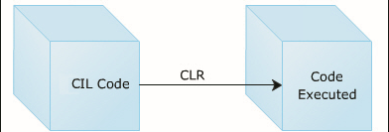
Common Language Runtime (CLR) 2-3
When a code is executed for the first time;
The CIL code is converted to a code native to the operating system.
This is done at runtime by the Just-In-Time (JIT) compiler present in the CLR.
The CLR converts the CIL code to the machine language code.
Once this is done, the code can be directly executed by the CPU.
The following figure depicts the working of the CLR:

Slide 15
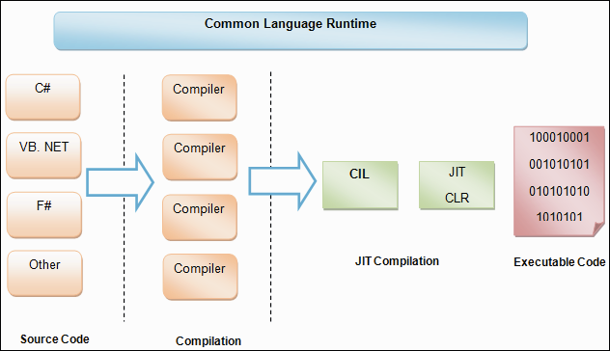
Common Language Runtime (CLR) 3-3
The following figure shows a more detailed look at the working of the CLR:

Slide 16
Dynamic Language Runtime (DLR)
Dynamic Language Runtime (DLR):
Is a runtime environment built on top of the CLR to enable interoperability of dynamic languages such as Ruby and Python with the .NET Framework.
Allows creating and porting dynamic languages to the .NET Framework.
Provides dynamic features to the existing statically typed languages. For example, C# relies on the DLR to perform dynamic binding.
The .NET Framework languages, such as C#, VB, and J# are statically typed languages.
In dynamic languages, programmers are not required to specify object types in the development phase.

Slide 17
Need for a New Language
Microsoft introduced C# as a new programming language to address the problems posed by traditional languages.
C# was developed to:
Create a very simple and yet powerful tool for building interoperable, scalable, and robust applications.
Create a complete object-oriented architecture.
Support powerful component-oriented development.
Allow access to many features previously available only in C++ while retaining the ease-of-use of a rapid application development tool such as Visual Basic.
Provide familiarity to programmers coming from C or C++ background.
Allow to write applications that target both desktop and mobile devices.

Slide 18
Purpose of C# Language
Microsoft .NET was formerly known as Next Generation Windows Services (NGWS).
It is a completely new platform for developing the next generation of Windows/Web applications.
These applications transcend device boundaries and fully harness the power of the Internet.
However, building the new platform required a language that could take full advantage.
This is one of the factors that led to the development of C#.
C# is an object-oriented language derived from C and C++.
The goal of C# is to provide a simple, efficient, productive, and object-oriented language that is familiar and yet at the same time revolutionary.

Slide 19
Language Features
C# has features common to most object-oriented languages.
It has language-specific features, such as:
Type safety checking
Generics
Indexers
These features make the C# as a preferred language to create a wide variety of applications.

Slide 20
Basic Features of C# 1-3
C# is a programming language designed for building a wide range of applications that run on the .NET Framework.
Following are some basic key features of C#:
Object-oriented Programming
Type-safety Checking
Garbage Collection
Standardization by European Computer Manufacturers Association (ECMA)
Generic Types and Methods
Iterators
Static Classes
Partial Classes
Anonymous Methods
Methods with named Arguments
Methods with optional Arguments
Nullable Types
Accessor Accessibility
Auto-implemented Properties
Parallel Computing

Slide 21
Basic Features of C# 2-3
Object-oriented Programming:
Focuses on objects so that code written once can be reused. This helps reduce time and effort on the part of developers.
Type-safety Checking:
Checked the overflow of types because uninitialized variables cannot be used in C# as C# is a case-sensitive language.
Garbage Collection:
Performs automatic memory management from time to time and spares the programmer the task.
Standardization by European Computer Manufacturers Association (ECMA):
Specifies the syntax and constraints used to create standard C# programs.
Generic Types and Methods:
Are a type of data structure that contains code that remains the same throughout but the data type of the parameters can change with each use.
Iterators: Enable looping (or iterations) on user-defined data types with the for each loop.
Static Classes: Contain only static members and do not require instantiation.

Slide 22
Basic Features of C# 3-3
Partial Classes: Allow the user to split a single class into multiple source code (.cs) files.
Anonymous Methods: Enable the user to specify a small block of code within the delegate declaration.
Methods with named Arguments: Enable the user to associate a method argument with a name rather than its position in the argument list.
Methods with optional Arguments: Allow the user to define a method with an optional argument with a default value.
Nullable Types: Allow a variable to contain a value that is undefined.
Accessor Accessibility: Allows the user to specify the accessibility levels of the get and set accessors.
Auto-implemented Properties: Allow the user to create a property without explicitly providing the methods to get and set the value of the property.
Parallel Computing: Support for parallel programming using which develop efficient, fine-grained, and scalable parallel code without working directly with threads or the thread pool.

Slide 23
Applications of C#
C# is an object-oriented language that can be used in a number of applications.
Following are some of the applications:
Web applications
Web services
Gaming applications
Large-scale enterprise applications
Mobile applications for pocket PCs, PDAs, and cell phones
Simple standalone desktop applications such as Library Management Systems, Student Mark Sheet generation, and so on
Complex distributed applications that can spread over a number of cities or countries
Cloud applications

Slide 24
Advantages of C#
C# has become a preferred programming language over C++ because of its simplicity and user-friendliness.
The advantages of C# are as follows:
Cross Language Support:
The code written in any other .NET language can be easily used and integrated with C# applications.
Common Internet Protocols:
.NET offers extensive support for XML, which is the preferred choice for formatting information over the Internet.
Additionally, support for transfer via SOAP is also integrated.
Simple Deployment:
Deployment of C# applications is made simple by the concept of assemblies.
An assembly is a self-describing collection of code and resources.
It specifies exactly the location and version of any other code it needs.
XML Documentation:
Comments can be placed in XML format and can then be used as needed to document your code.
It can include example code, parameters, and references to other topics.
It makes sense for a developer to document his or her code because those comments can actually become documentation independent of the source code.

Slide 25
Memory Management
In programming languages like C and C++, the allocation and de-allocation of memory is done manually.
Performing these tasks manually is both, time-consuming and difficult.
The C# language provides the feature of allocating and releasing memory using automatic memory management.
This means that there is no need to write code to allocate memory when objects are created or to release memory when objects are not required in the application.
Automatic memory management increases the code quality and enhances the performance and the productivity.

Slide 26
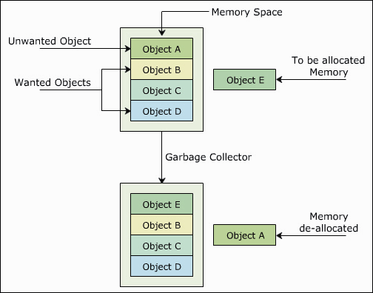
Garbage Collection
Garbage collection:
Is the process of automatic reclaiming of memory from objects that are no longer in scope.
Helps the process of allocating and de-allocating memory using automatic memory management.
The following figure illustrates concept of garbage collection:

Slide 27
Visual Studio 2012 Environment
Visual Studio 2012 Environment:
Provides the environment to create, deploy, and run applications developed using the .NET framework.
Comprises the Visual Studio Integrated Development Environment (IDE), which is a comprehensive set of tools, templates, and libraries required to create .NET framework applications.
Is a complete set of development tools for building high performance desktop applications, XML Web Services, mobile applications, and ASP Web applications.
Is also used to simplify team-based design, development, and deployment of enterprise solutions.
Is an IDE used to ease the development process of .NET applications such as Visual C# 2012 and Visual Basic 2012.
Uses the same IDE, debugger, Solution Explorer, Properties tab, Toolbox, standard menus, and toolbars for all the .NET compatible languages.

Slide 28
Visual Studio 2012 Editions
The IDE of Microsoft Visual Studio is a result of extensive research by the Microsoft team.
The different editions of Visual Studio 2012 are:
Visual Studio Professional 2012
This is the entry-level edition that provides support for developing and debugging applications, such as Web, desktop, cloud-based, and mobile applications.
Visual Studio Professional 2012 with MSDN
This edition provides all the features of the Visual Studio Professional 2012 edition along with an MSDN subscription.
In addition, this edition includes Team Foundation Server and provides access to cloud, Windows Store, and Windows Phone Marketplace.
Visual Studio Test Professional 2012 with MSDN
This edition targets testers and Quality Assurance (QA) professionals by providing project management tools, testing tools, and virtual environment to perform application testing.
Visual Studio Premium 2012 with MSDN
This edition provides all the features of the combined Visual Studio Professional 2012 and Visual Studio Test Professional 2012 with MSDN editions.
In addition, this edition supports peer code review, User Interface (UI) validation through automated tests, and code coverage analysis to determine the amount of code being tested.
Visual Studio Ultimate 2012 with MSDN
This edition has all the features of the other editions. In addition, this edition supports designing architectural layer diagrams, performing Web performance and load testing, and analyzing diagnostic data collected from runtime systems.

Slide 29
Languages in Visual Studio 2012
Visual Studio 2012 supports multiple programming languages such as:
Visual Basic .NET
Visual C++
Visual C#
Visual J#
The classes and libraries used in the Visual Studio 2012 IDE are common for all the languages in Visual Studio 2012.
It makes Visual Studio 2012 more flexible.

Slide 30
Features of Visual Studio 2012 1-2
The features of Visual Studio 2012 are:
Comprehensive Tools Platform:
In Visual Studio 2012, developers of all knowledge levels can make use of developer tools, which offer a development experience tailored for their unique needs.
Reduced Development Complexity:
Visual Studio 2012 enables customers to deliver more easily a broad range of .NET Framework-based solutions including Windows, Office, Web, and mobile applications.
Edit Marks:
Visual Studio 2012 provides a visual indication of the changes that are made and not saved and changes that are made during the current session that have been saved to the disk.
Code Snippets:
Code Snippets are small units of C# source code that the developer can use quickly with the help of certain keystrokes.

Slide 31
Features of Visual Studio 2012 2-2
AutoRecover:
Visual Studio 2012 automatically saves the work on a regular basis and thus, minimizes loss of information due to unexpected closing of unsaved files.
In case of an IDE crash, Visual Studio 2012 will also prompt you to recover your work after you restart.
IntelliSense:
Visual Studio 2012 has the IntelliSense feature in which syntax tips, lists of methods, variables and classes pop up continually when entering code in the Code Editor, making the process of entering code more efficient.
Refactoring:
Refactoring enables developers to automate common tasks when restructuring code.
It changes the internal structure of the code, specifically the design of its objects, to make it more comprehensible, maintainable, and efficient without changing its behavior.

Slide 32
Elements of Microsoft Visual Studio 2012 IDE
Visual Studio 2012 contains an extensive set of elements, comprising of editors, toolbox, and different windows to assist developers in creating .NET applications.
The key elements in Visual Studio 2012 IDE are:
Solution Explorer
Code Editor
Properties Window
Toolbox
Server Explorer
Output Window
Error List
Dynamic Help

Slide 33
Example
Create a New Project:
Following are the steps to create a new project:
Start Visual Studio 2012.
Select New 🡪 Project from the File menu.
Expand the Templates 🡪 Visual C# nodes in the left pane and select Console Application in the right pane of the New Project dialog box.
Specify the name and location for the project and click OK. Visual Studio 2012 opens the Code Editor with the skeleton code of a class, as shown in the following code:
Add the following code after the opening curly brace of the Main(string[] args) method definition:
Console.WriteLine("This is a sample C# program");
using System;
using System.Collections.Generic;
using System.Linq;
using System.Text;
using System.Threading.Tasks;
namespace SampleProgram
{
class Program
{
static void Main(string[] args)
{
}
}
}
Snippet

Slide 34
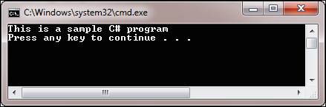
Build and Execute
The IDE also provides the necessary support to compile and execute C# programs.
Following are the steps to compile and execute C# programs:
Compiling the C# Program
Select Build <application name> from the Build menu. This action will create an executable file (.exe).
Executing the Program:
Select Start Without Debugging from the Debug menu.

Slide 35
Summary
The .NET Framework is an infrastructure that enables building, deploying, and running different types of applications and services using .NET technologies.
The two core components of the .NET Framework which are integral to any application or service development are the CLR and the .NET Framework class library.
The CLR is a virtual machine component of .NET that is used to convert the CIL code to the machine language code.
C# is an object-oriented language derived from C and C++.
The C# language provides the feature of allocating and releasing memory using automatic memory management.
Visual Studio 2012 provides the environment to create, deploy, and run applications developed using the .NET framework.
Some of the languages supported by Visual Studio 2012 include Visual Basic .NET, Visual C++, Visual C#, Visual J#, and Visual F#.

Slide 36

THANKS FOR WATCHING !

